Slide 1



P3- Visualizing Carbon Footprints Across Sectors Using Power BI
https://github.com/SanjanaKiran456/P3-Visualizing-Carbon-Footprints-Across-Sectors-Using-Power-BI.git

Slide 2

Learning Objectives
To develop the ability to collect, process, and visualize environmental data using Power BI, with a focus on analyzing and interpreting carbon emissions across multiple countries, sectors, and time periods. The project aims to enhance data storytelling skills through interactive dashboards that highlight sector-wise, country-wise, and year-wise carbon footprint distribution
GOAL
Source :
www.freepik.com/

Slide 3
Tools and Technology used
1. Power BI Desktop
Used for data visualization, creating interactive dashboards, and generating insights.
Features used:
Slicers, Filters
Bar charts, Pie charts, Line graphs, Tree maps, Tables
Data modeling and relationships
3. DAX (Data Analysis Expressions)(if applied)
Power BI’s formula language for creating calculated columns and measures.
Example use: calculating total emissions, percentage share, or year-over-year change.
2. Microsoft Excel
Used for data storage and preprocessing before importing into Power BI.
Likely used for:
Tabular data formatting
Aggregating or merging sector-wise/country-wise carbon emission data
4. Data Sources
Example datasets from:
India_Carbon_Emission
summary_of_carbon_emission
Could be in CSV/Excel format

Slide 4
Methodology
Problem Identification:
Needed a way to visualize carbon emissions by country, sector, and year.
Data Collection:
Collected carbon emission data (2019–2023) from various sectors and countries.
Data Preparation:
Cleaned and formatted the data in Power BI; handled missing values.
Data Modeling:
Linked tables by sector, country, and year for better analysis.
Visualization:
Created interactive dashboards with charts, treemaps, and slicers for easy filtering.
Insight Generation:
Found emission trends and identified top polluting sectors and countries.

Slide 5
Problem Statement:
Visualizing Carbon Footprints Across Sectors Using Power BI
Raw carbon emission data across sectors and countries is often difficult to interpret.
This project aims to simplify and visualize this data using Power BI, making it easier to analyze emission patterns and support informed environmental decisions.

Slide 6
Solution:
The solution involves building a comprehensive and interactive Power BI dashboard that allows users to explore carbon emission data across different sectors, countries, and time periods. By importing, transforming, and visualizing the data, the dashboard helps:
Simplify complex emission data through clear visuals like bar charts, pie charts, treemaps, and line graphs.
Identify top contributing sectors and countries to carbon emissions.
Track emission trends over time (2019–2023) using year-wise comparisons.
Enable dynamic filtering by country, sector, and year for deeper insights.
Support data-driven decision-making for environmental awareness and policy planning.

Slide 7
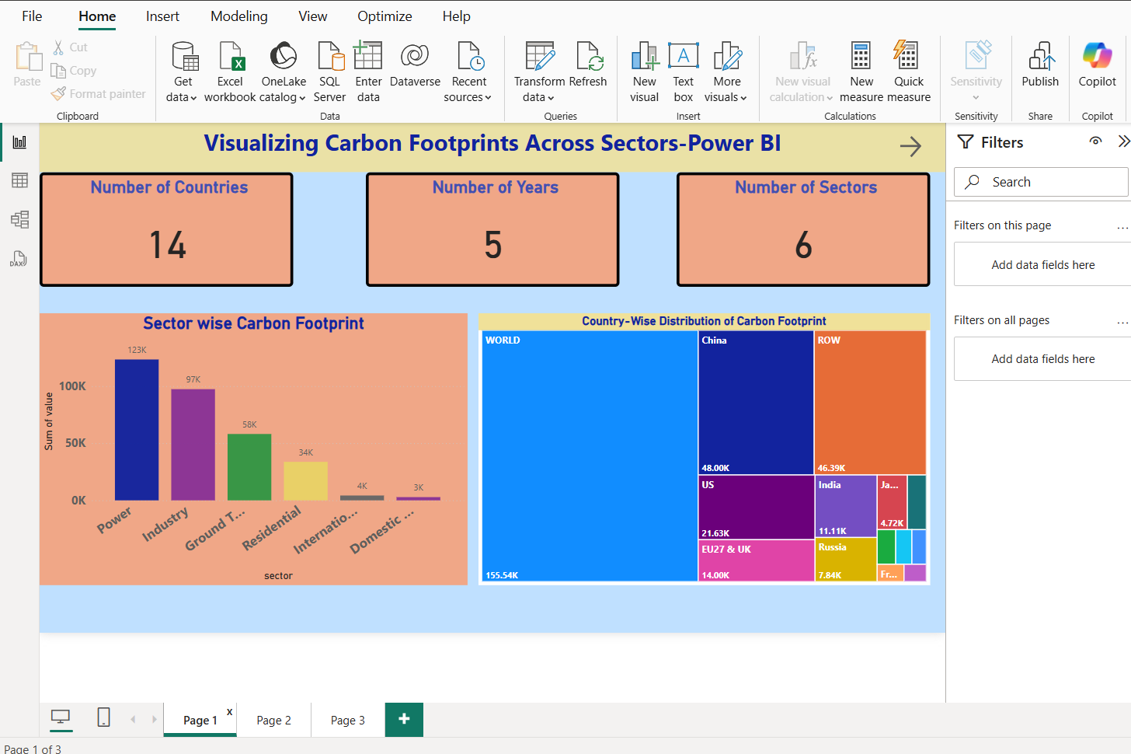
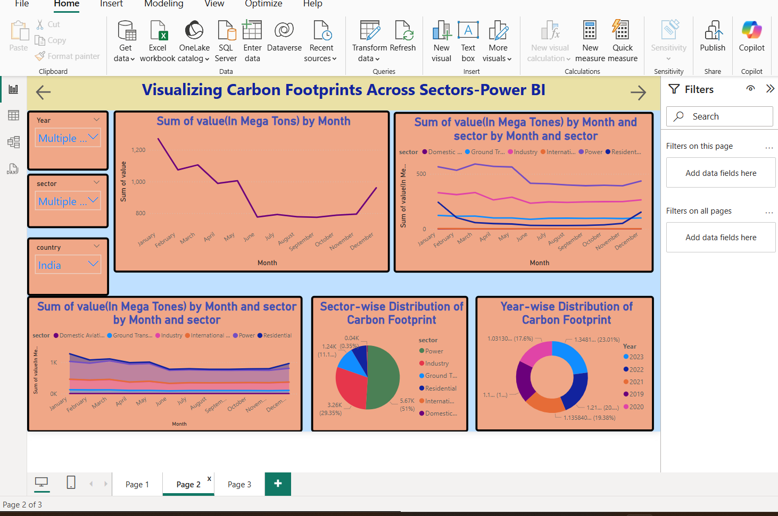
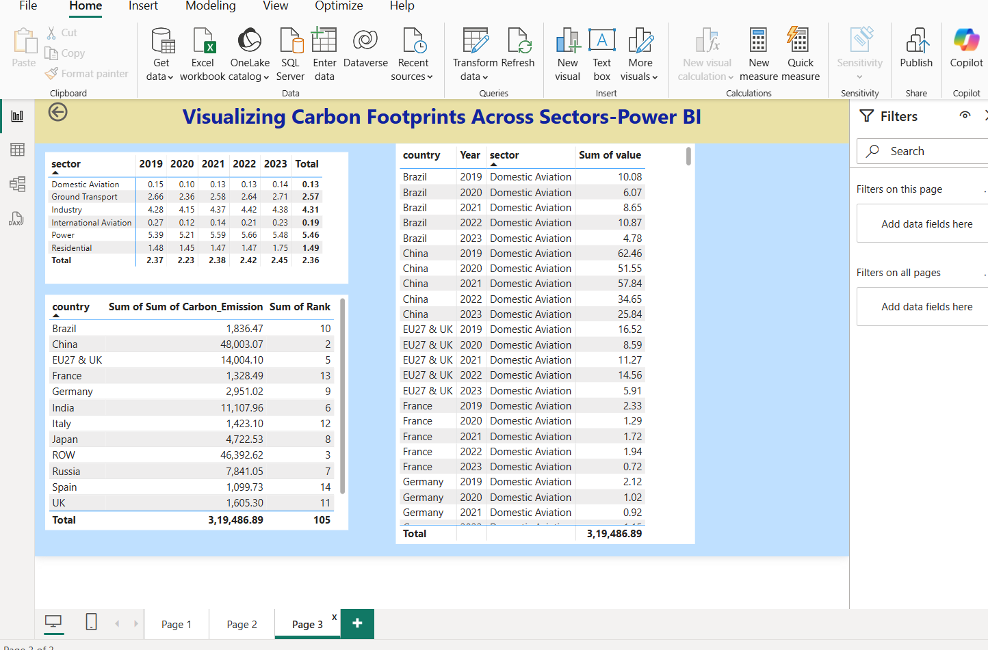
Screenshot of Output:

Slide 8
Conclusion:
This project successfully demonstrates how Power BI can be used to transform raw carbon emission data into interactive and insightful visualizations. By analyzing carbon footprints across different sectors, countries, and years, the dashboard provides a clear understanding of emission patterns and trends.
It enables users to identify key contributors, monitor changes over time, and make informed decisions related to environmental impact and sustainability. Overall, the project highlights the importance of data visualization in raising awareness and supporting global efforts toward reducing carbon emissions

